Slide 1
User Interface Design

Slide 2
Designing User Interface
An effective communication medium between a human and a computer
Identification of interface objects and actions
Creation of a screen layout
Study of people and how they relate to technology by answering questions like:
Who is the user?
How does the user learn to interact with the system?
How does the user interpret info produced by the system?
What will the user expect of the system?

Slide 3
Golden Rules
Place the User in Control
Reduce User’s Memory Load
Make the Interface Consistent

Slide 4
Place the user in control
System should react to user needs
System should help the user complete tasks
User should not feel that the system is controlling the user

Slide 5
Place the user in control
Design Principles:
Define interactions s.t. a user is not forced into unnecessary/undesired actions/modes
Provide flexible interaction
User should not feel that the system is controlling the user
Allow interruptible and undoable user interactions
Streamline interactions based on skill level, allow interactions to be customized
Hide technical internals from casual user
Provide mechanism for direct interaction with objects on screen

Slide 6
Reduce the user’s memory load
The more a user has to remember, the more error-prone the interaction
Design principles:
Reduce demand on short term memory
Establish meaningful defaults
Define shortcuts that are intuitive
Disclose information in a progressive manner

Slide 7
Make the interface consistent
Maintain design rules for all screens
Design principles:
Allow user to put current task into a meaningful context
Maintain consistency across a complete product line
Avoid violating de facto standards

Slide 8
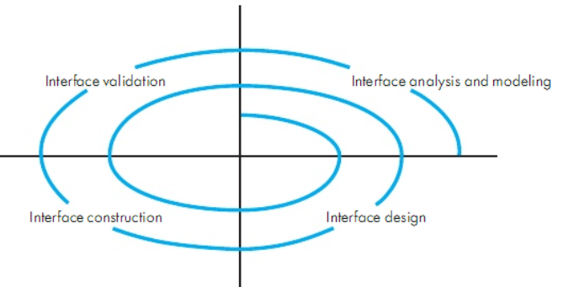
UID Process

Slide 9
UID Process
Interface Analysis
User Model
Profile of end user
Age, gender, education, physical abilities, cultural/ethnic background etc.
Novice, Knowledgeable, Knowledgeable frequent users
Design Model
Mental Model
User’s perception of the system
Implementation Model

Slide 10
UID Process
Interface Design
Define interface objects and actions
Interface Construction
Creation of prototypes to evaluate usage scenarios
Interface Validation
Ability to implement every user task correctly
Degree to which interface is easy to use
User’s acceptance to user interface as useful

Slide 11
Interface Analysis
User Analysis
Trained professionals? Technicians? Clerks? Etc.
Average level of formal education?
User capability to learn from written material/training?
Expert typists? Do not like keyboard?
Age range?
Users represented predominantly by one gender?
Routine of work? Regular? Overtime?
Frequency of usage?
Primary spoken language of users?
Subject matter experts?
Desire to know underlying technology

Slide 12
Interface Analysis
Task Analysis
Work performed by user in particular circumstances
Tasks/subtasks performed by the user during the work being performed
Problem domain objects manipulated by users
Sequence of work tasks? Flow of actions? The workflow?
Hierarchy of tasks
Techniques used to support task analysis
Usecases
Task Elaboration
Object Elaboration
Workflow Analysis(Swimlane Diagram)

Slide 13
Interface Analysis
Analysis and display content
Different types of data assigned to consistent locations on screen?
Customizable location of content on screen
Partitioning of large objects (e.g. reports) for better understanding
Use of colors to improve understanding
Content of error messages?

Slide 14
Interface Design
Define interface objects and operations
Model system behavior on events that change state of the interface
Indicate user interpretation of the state of the system

Slide 15
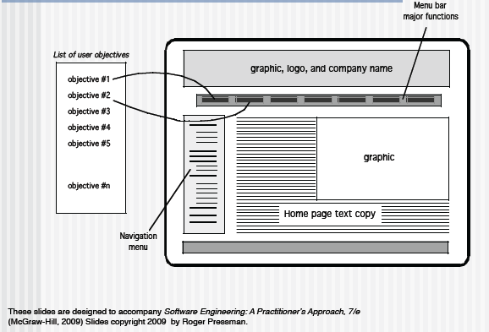
Mapping User Objectives

Slide 16
Design Issues
Task | Response time (seconds)
1 | 2
2 | 1
3 | 3
4 | 4
5 | 3
Mean
Standard deviation
Response time
Length
Variability
Interaction rhythm
Help
Help without leaving the interface?
Error information handling
Command labeling
Power users?
Task | Response time (seconds)
1 | 1.5
2 | 1
3 | 2
4 | 1.25
5 | 2.25
Mean
Standard deviation

Slide 17
Representing Design(Exercise) Sidebar 6.4 Royal Service Station Requirements of PFleeger
Royal Service station provides three types of services
The system must track bills, the product and services
System to control inventory
The system to track credit history, and payments overdue
The system applies only to regular repeat customer
The system must handle the data requirements for interfacing with other system
The system must record tax and related information
The station must be able to review tax record upon demand
The system will send periodic message to customers
Customer can rent parking space in the station parking lot
The system maintain a repository of account information
The station manager must be able to review accounting information upon demand
The system can report an analysis of prices and discounts
The system will automatically notify the owners of dormant accounts
The system can not be unavailable for more than 24 hours
The system must protect customer information from unauthorized access

Slide 18
Representing Design(Exercise) Sidebar 6.4 Royal Service Station Requirements of PFleeger
Give an architecture diagram (with architecture styles mentioned and labelled)
Give a component diagram
Give a table with a list of screens, each screen’s title, actors using the screen, fields etc on the screen, anything else that is important

Slide 19
Other Design Considerations Designing User Interfaces
Must consider several issues:
identifying the humans who will interact with the system
defining scenarios for each way that the system can perform a task
designing a hierarchy of user commands
refining the sequence of user interactions with the system
designing relevant classes in the hierarchy to implement the user-interface design
decisions
integrating the user-interface classes into the overall system class hierarchy

Slide 20
UI Trends
Minimalism
Skeumorphism
Laser Focus
Context Sensitive Navigation
Collapsed Content
Content Chunking
Long Pages
For details see http://www.authorstream.com/Presentation/umr17-1645231-pressman-ch-12-user-interface-design/

Slide 21
Design Evaluation
Evolutionary…

Slide 22
Other Design Considerations Designing User Interfaces
Must consider several issues:
identifying the humans who will interact with the system
defining scenarios for each way that the system can perform a task
designing a hierarchy of user commands
refining the sequence of user interactions with the system
designing relevant classes in the hierarchy to implement the user-interface design
decisions
integrating the user-interface classes into the overall system class hierarchy

Slide 23
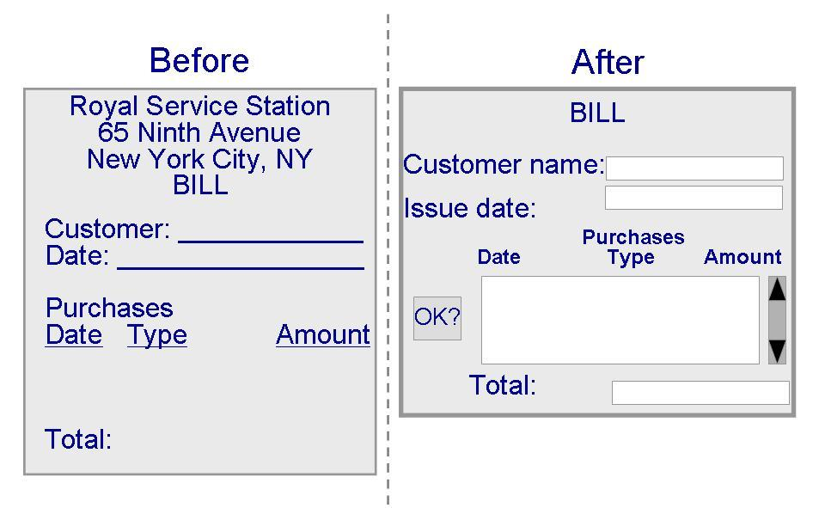
Other Design Considerations Designing User Interfaces (continued)

Slide 24
References
UCF slides for SE course (a few slides have been reused)
SE book by Pressman
SE book by Pfleeger
SE book by Ian Sommerville

